Slide 1
RÉsumÉ
Personal Finance
Objective: Create an effective résumé

Slide 2
What not to do

Slide 3
What is a Résumé?
One page summary of your skills, education and experience
An advertisement of you
It is the most important piece of writing you will ever create so it should be perfect
A good résumé is the key to getting a good job
Whenever you submit a résumé through an online file upload, always make sure that it is saved as a PDF.

Slide 4
How long do you think employers look at one resume?
6 seconds

Slide 5
What should be included in a resume
Heading/Letterhead
Bold
No funky fonts
Name
Address
Phone Number
Email Address

Slide 6
What should be included in a resume
Objective
One sentence explanation of the type of job you are seeking

Slide 7
What should be included in a resume
Education
High school students should only include high school information and anticipated graduation date
College students just put college information, no need to put high school information.
Dates of attendance or graduation
Major and degree for college students

Slide 8
What should be included in a resume
Work Experience
Include your job title, previous employers, their locations, your dates of employment
At least two one line descriptions of what your job duties and responsibilities were
Do NOT use “I” in descriptions
Use action verbs in your job descriptions to strengthen your resume
Administered
Composed
Eliminated
Handled
Analyzed
Repaired
Put in most recent order

Slide 9
What should be included in a resume

Slide 10
What should be included in a resume
Activities
List special activities you have participated in
Community Service
School activities and organizations
This is a relevant part of the resume for high school students but not as important for college students

Slide 12
Résumé for a High School Student
Items you can add to your résumé as a high school student
Major achievements
Awards and honors
Extracurricular activities
Skills

Slide 13
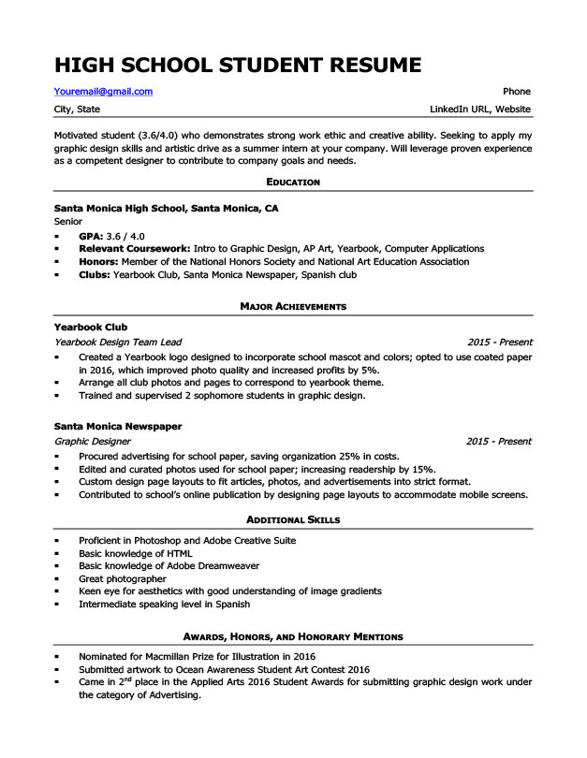

Slide 14
References
List of personal references
2-3 people who have observed your work habits (teachers, employers, coaches)
2-3 people who can speak of your character
Make sure you have asked them permission before you use them as a reference
Only ask people who will speak well of you
Include their place of employment, title, work address, work phone number, and email
You can let the employer know that references are available upon request
The references do not need to be included with the resume

Slide 15
Good Résumé Examples
Example 1
Example 2

Slide 16
Bad Résumé Examples
Example

Slide 17
Assignment
Posted on CANVAS

